Slide 1
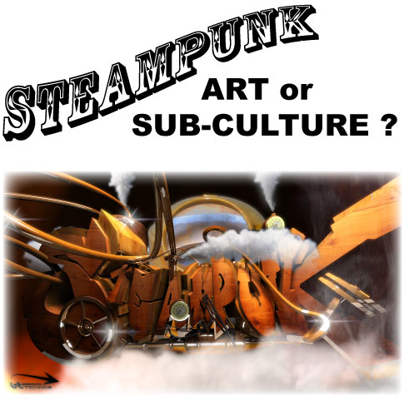

Slide 2
ART&100
Introduction to Art
Group Art Project: Steampunk
Presented by
Michael Sofie
Roxana Vidals
Corvus Woolf

Slide 3
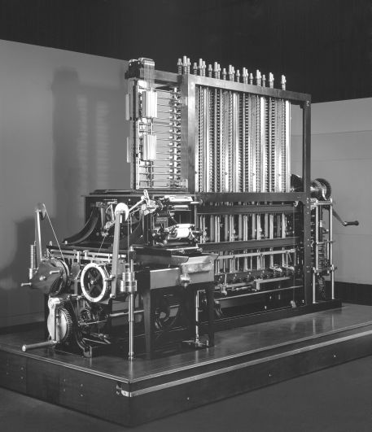
Charles Babbage’s Difference Engine #2 Designed 1840- never completed until 1991

Slide 4

Sherlock Holmes Film (2009) Set in 1891 London

Slide 5
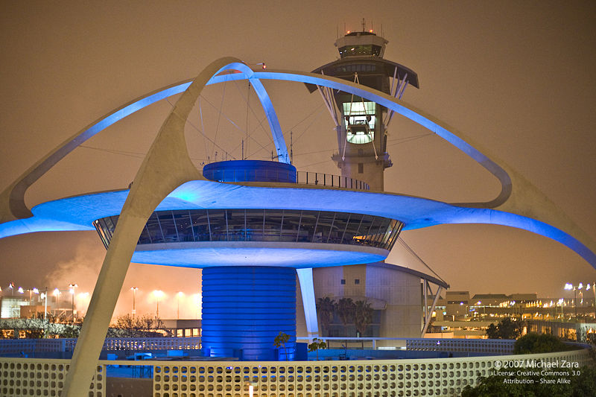
Googie or Populuxe Architecture LAX Terminal, Los Angeles (1961)

Slide 6

The Rocketeer Film (1991) Jetpack- Set in 1938

Slide 7
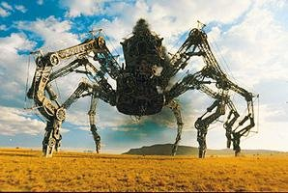
Wild Wild West Film (1999) Steam Powered Spider- setting 1870

Slide 8
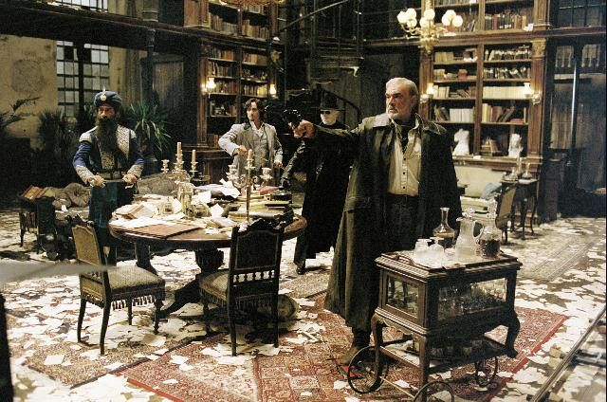
Leaque of Extraordinary Gentlemen Film (2003) adapted from comic book series

Slide 9
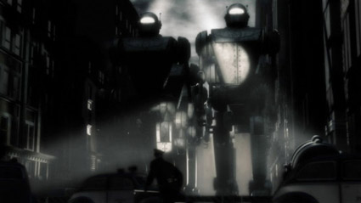
Sky Captain and the World of Tomorrow Film (2004) flying Giant Robots- set in alternative 1939

Slide 10
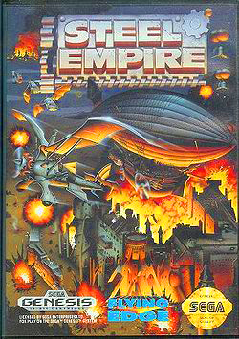
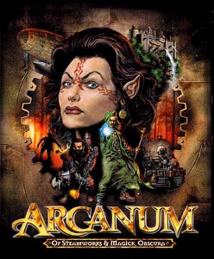
Role Playing Video Games

Slide 11
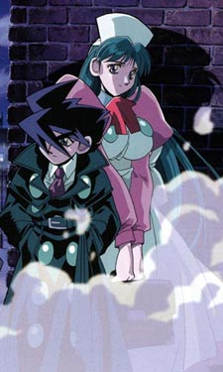
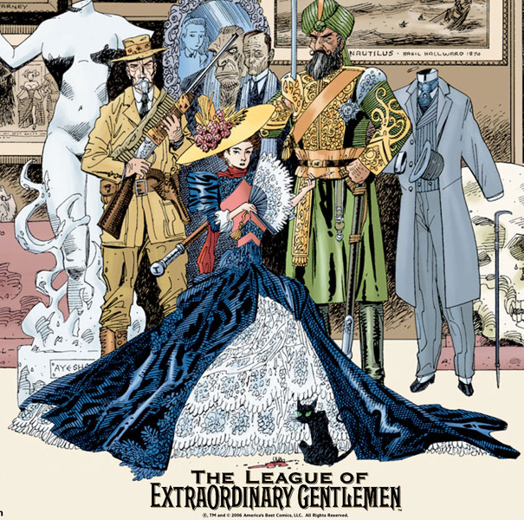
Graphic Novels Steam Detectives and Leaque of Extraordinary Gentlemen

Slide 12
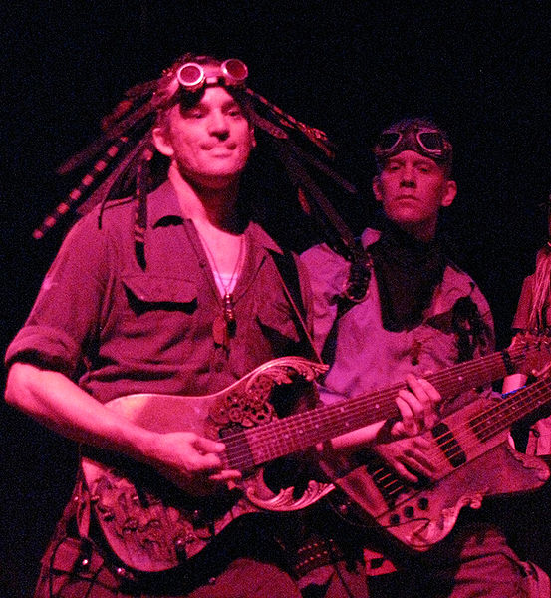
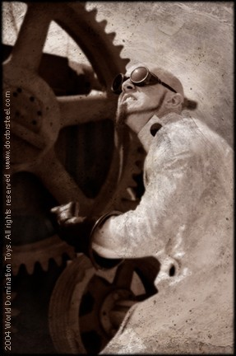
Steampunk Music Abney Park and Doctor Steel

Slide 13
“… steampunk reclaims technology for the masses. It substitutes metal and gears for silicon, pneumatic tubes for 3GH and wi-fi. It maximizes what was miniaturized and makes visible what was hidden …Steampunk is like a snapshot from the last moment in human history when technology was intelligible to the layman. “
Steampunk: Reclaiming Tech for the Masses
By Lev Grossman Monday, Dec. 14, 2009
http://www.time.com/time/magazine/article/0,9171,1945343,00.html#ixzz0hjmECIl2

Slide 14
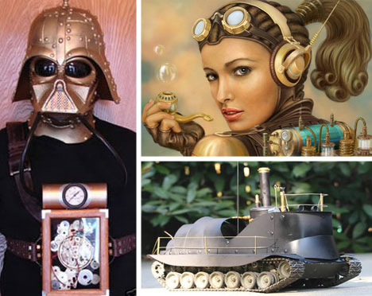
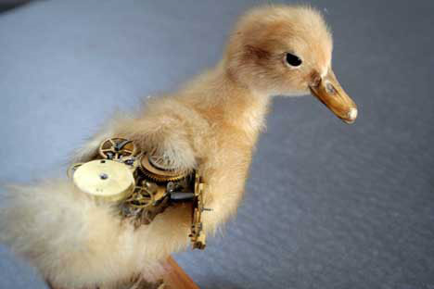
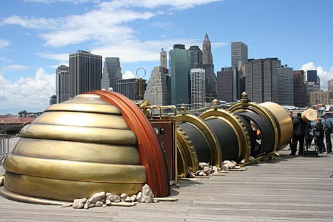
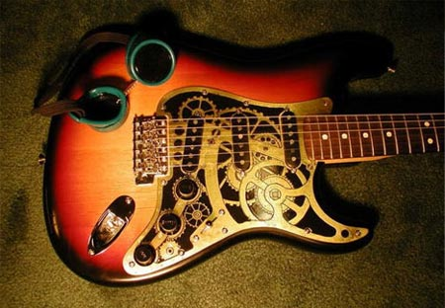
Notes:
14

Slide 15
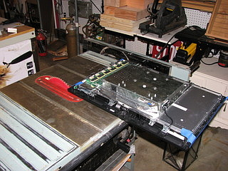
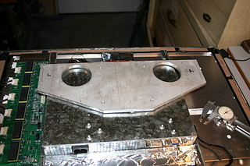
Making a Steampunk computer!
Notes:
15

Slide 16
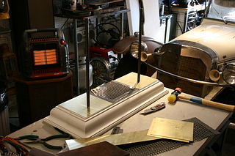
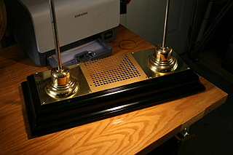
Notes:
16

Slide 17
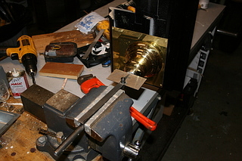
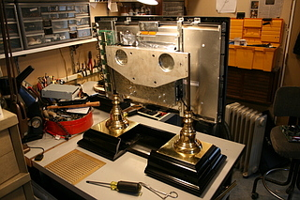
Notes:
17

Slide 18
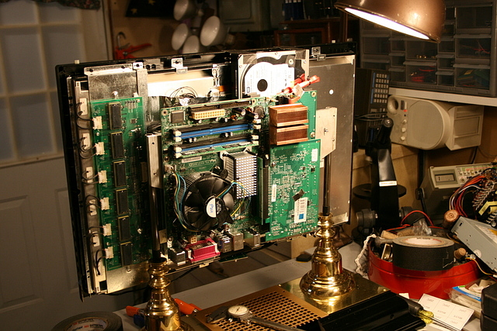
Notes:
18

Slide 19
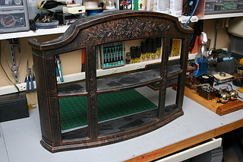
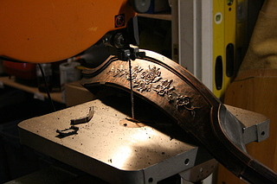
Notes:
19

Slide 20
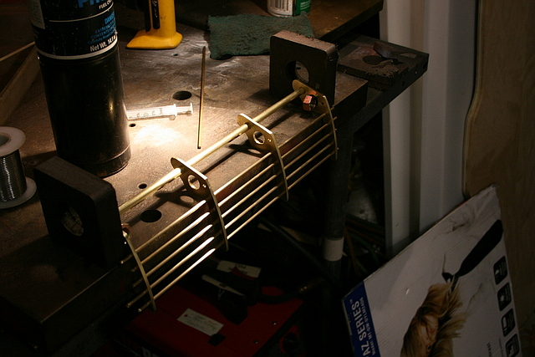
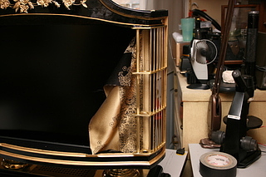
Notes:
20

Slide 21
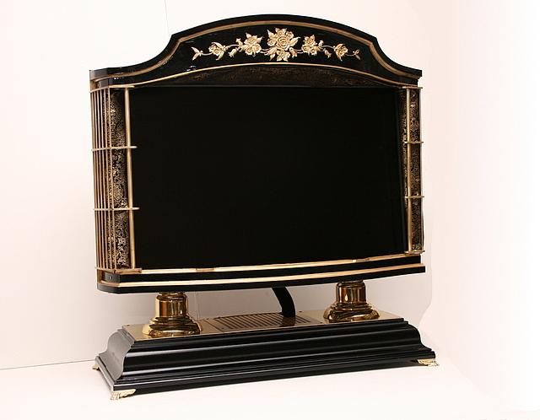
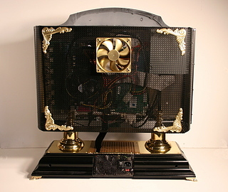
Notes:
21

Slide 22
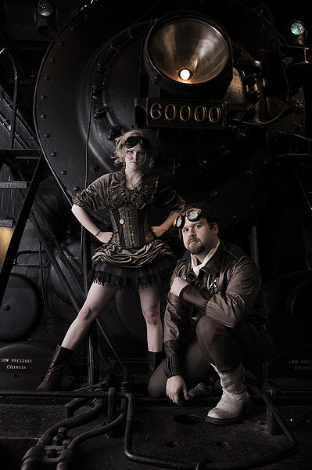
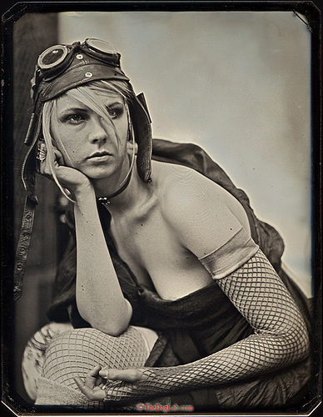
Steampunk Fashion
Notes:
22

Slide 23
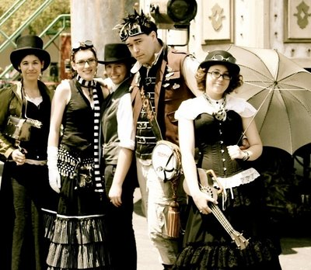
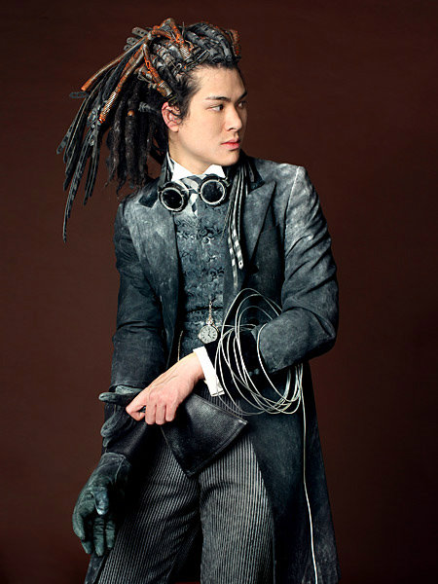
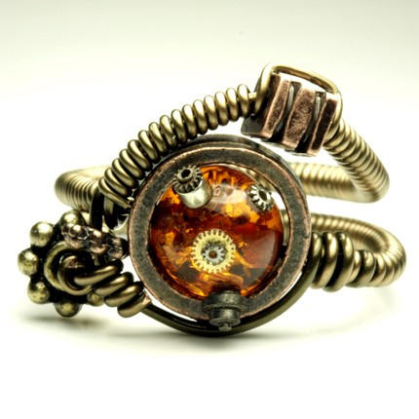
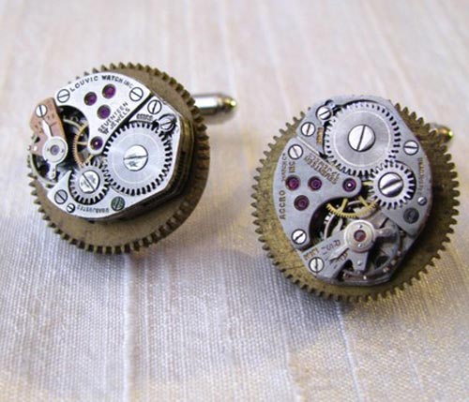
Notes:
23

Slide 24
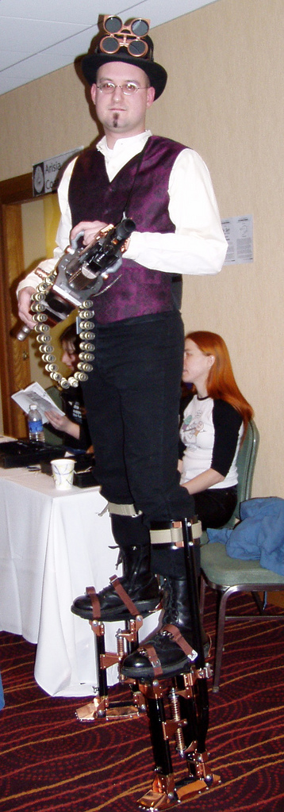
What is Steampunk
Speculative Fiction
Retro Futurism
Art Deco
Crafts Movement

Slide 25
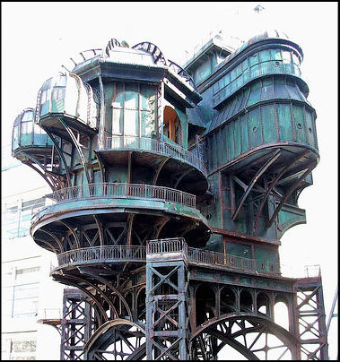
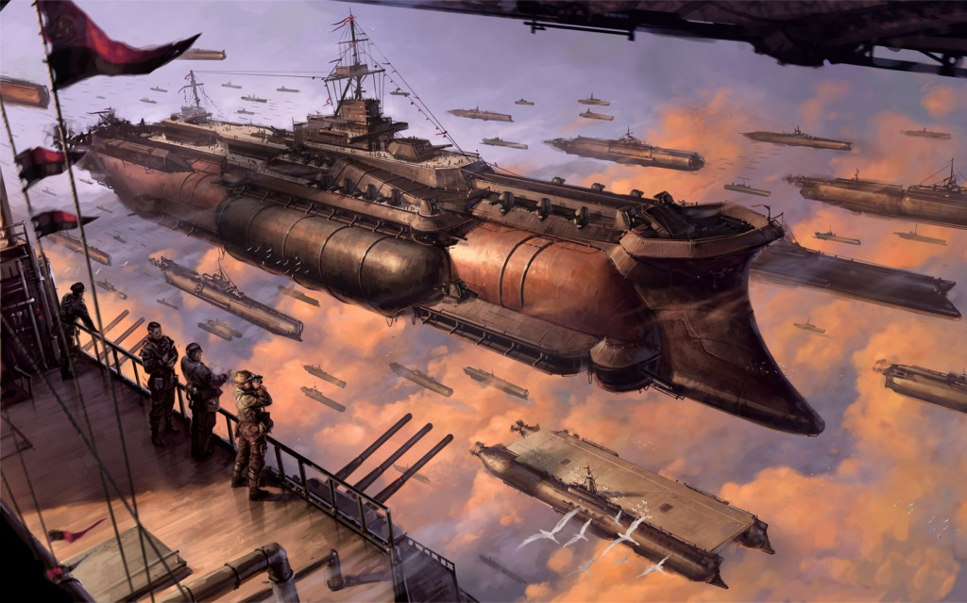
Victoria era - 1837 – 1901 Jules Verne -1828 – 1905

Slide 26
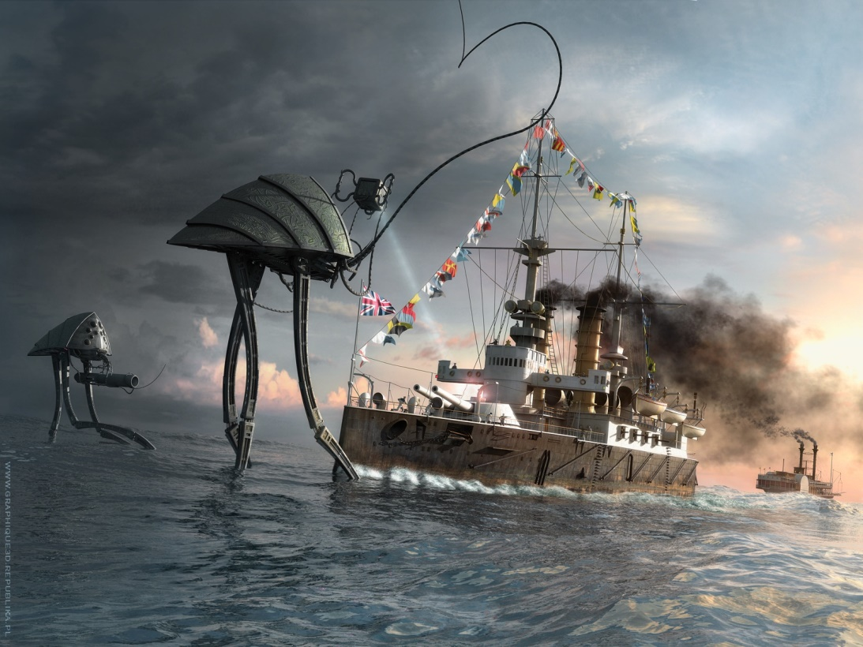
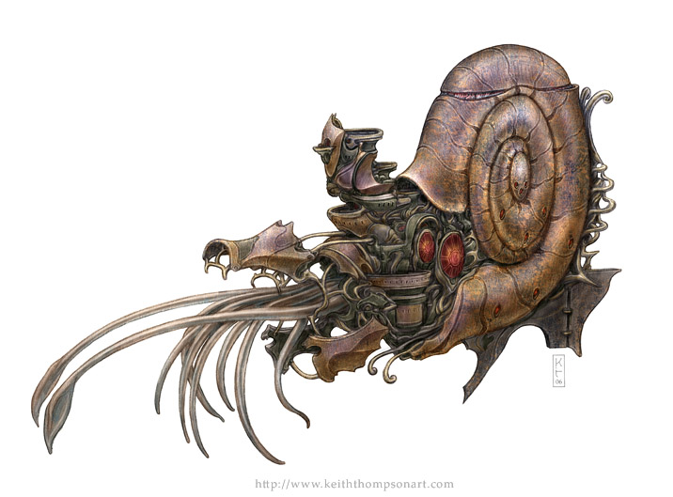
Science Fiction & Fantasy

Slide 27
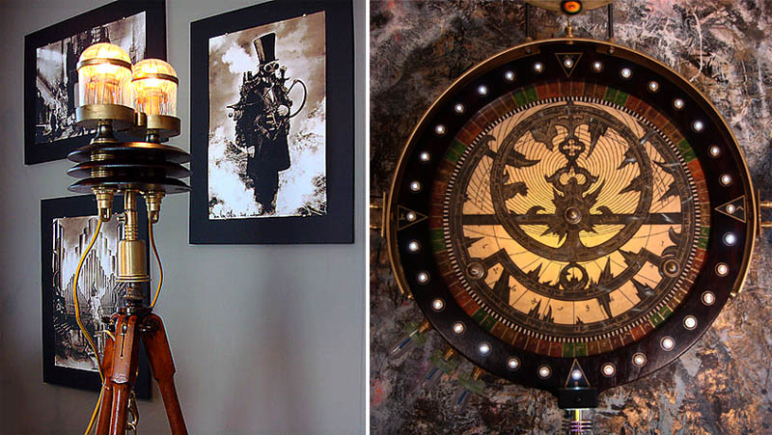
Is it an art movement?
An art movement is a tendency or style in art with a specific common philosophy or goal, followed by a group of artists during a restricted period of time…
-so says Wikipedia

Slide 28

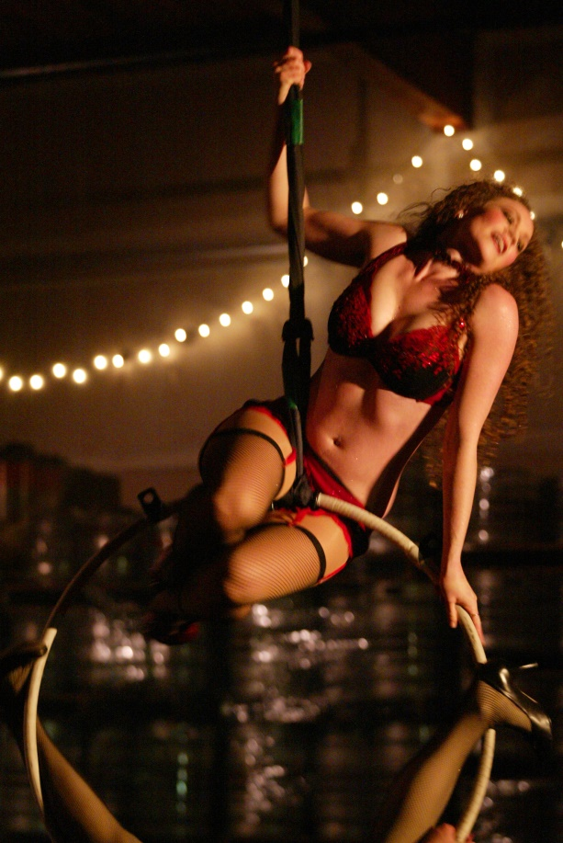

Modern Culture music, circus, burlesque

Slide 29
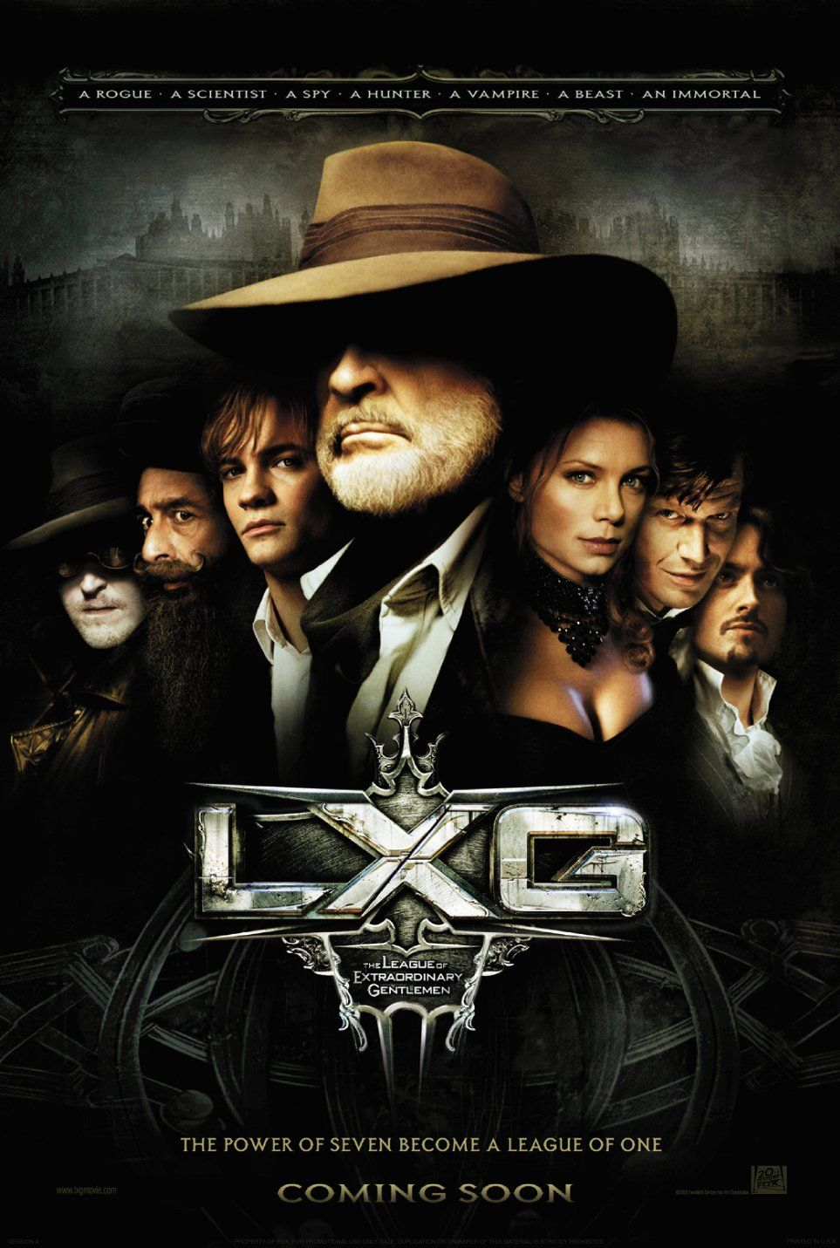
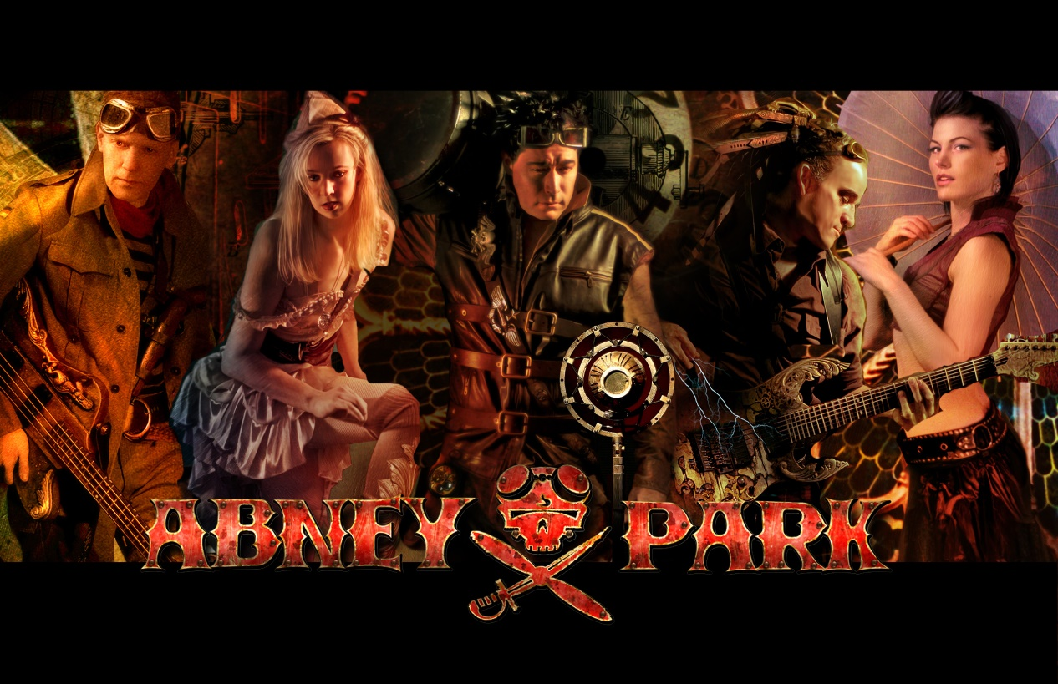
Music and Movies

Slide 30
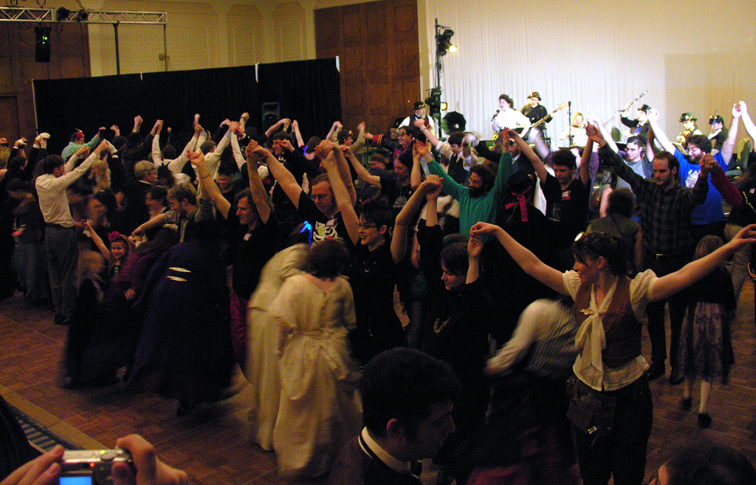
Conventions

Slide 31
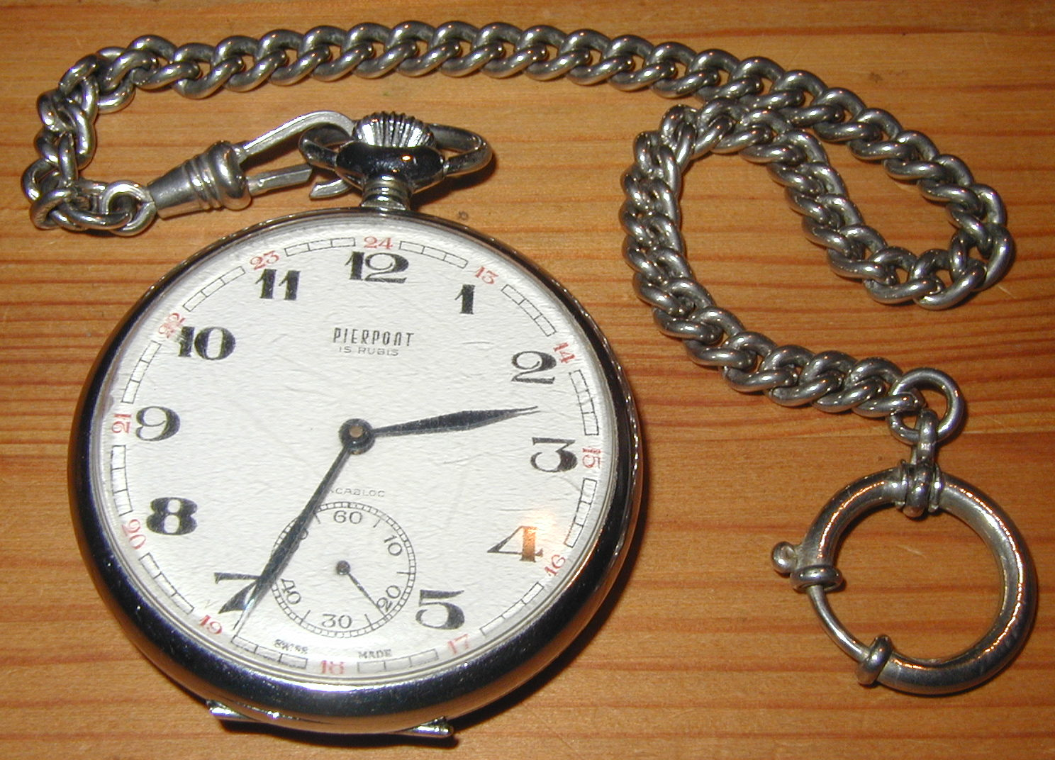
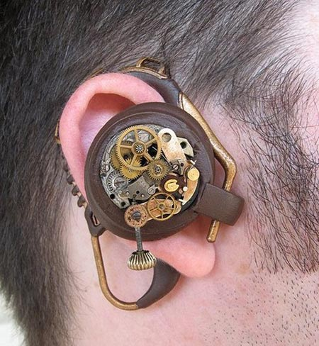
Accessible

Slide 32
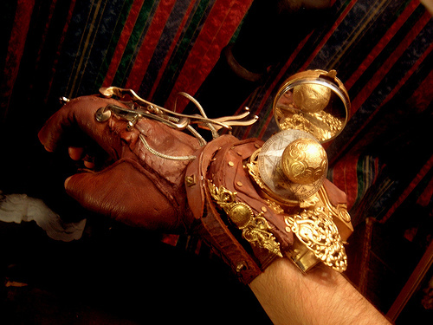
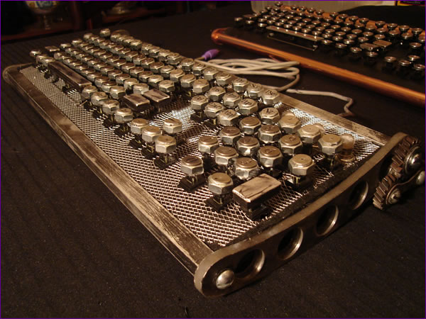
Excess and Positives

Slide 33
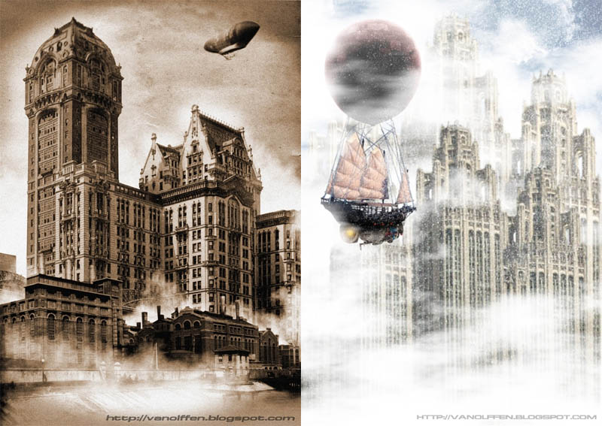
Steampunk is an art movement

Slide 34
Resources
http://en.wikipedia.org/wiki/Steampunk
http://en.wikipedia.org/wiki/Retro-futurism
http://www.steampunkmagazine.com/
http://brassgoggles.co.uk/blog/
http://en.wikipedia.org/wiki/List_of_steampunk_works
http://www.amazon.com/SteampunkMusic/lm/
R11IBPY7S6QHGF
http://en.wikipedia.org/wiki/Googie_architecture
http://www.time.com/time/magazine/article/0,9171,1945343,00.html#ixzz0hjmECIl2

